Slide 1
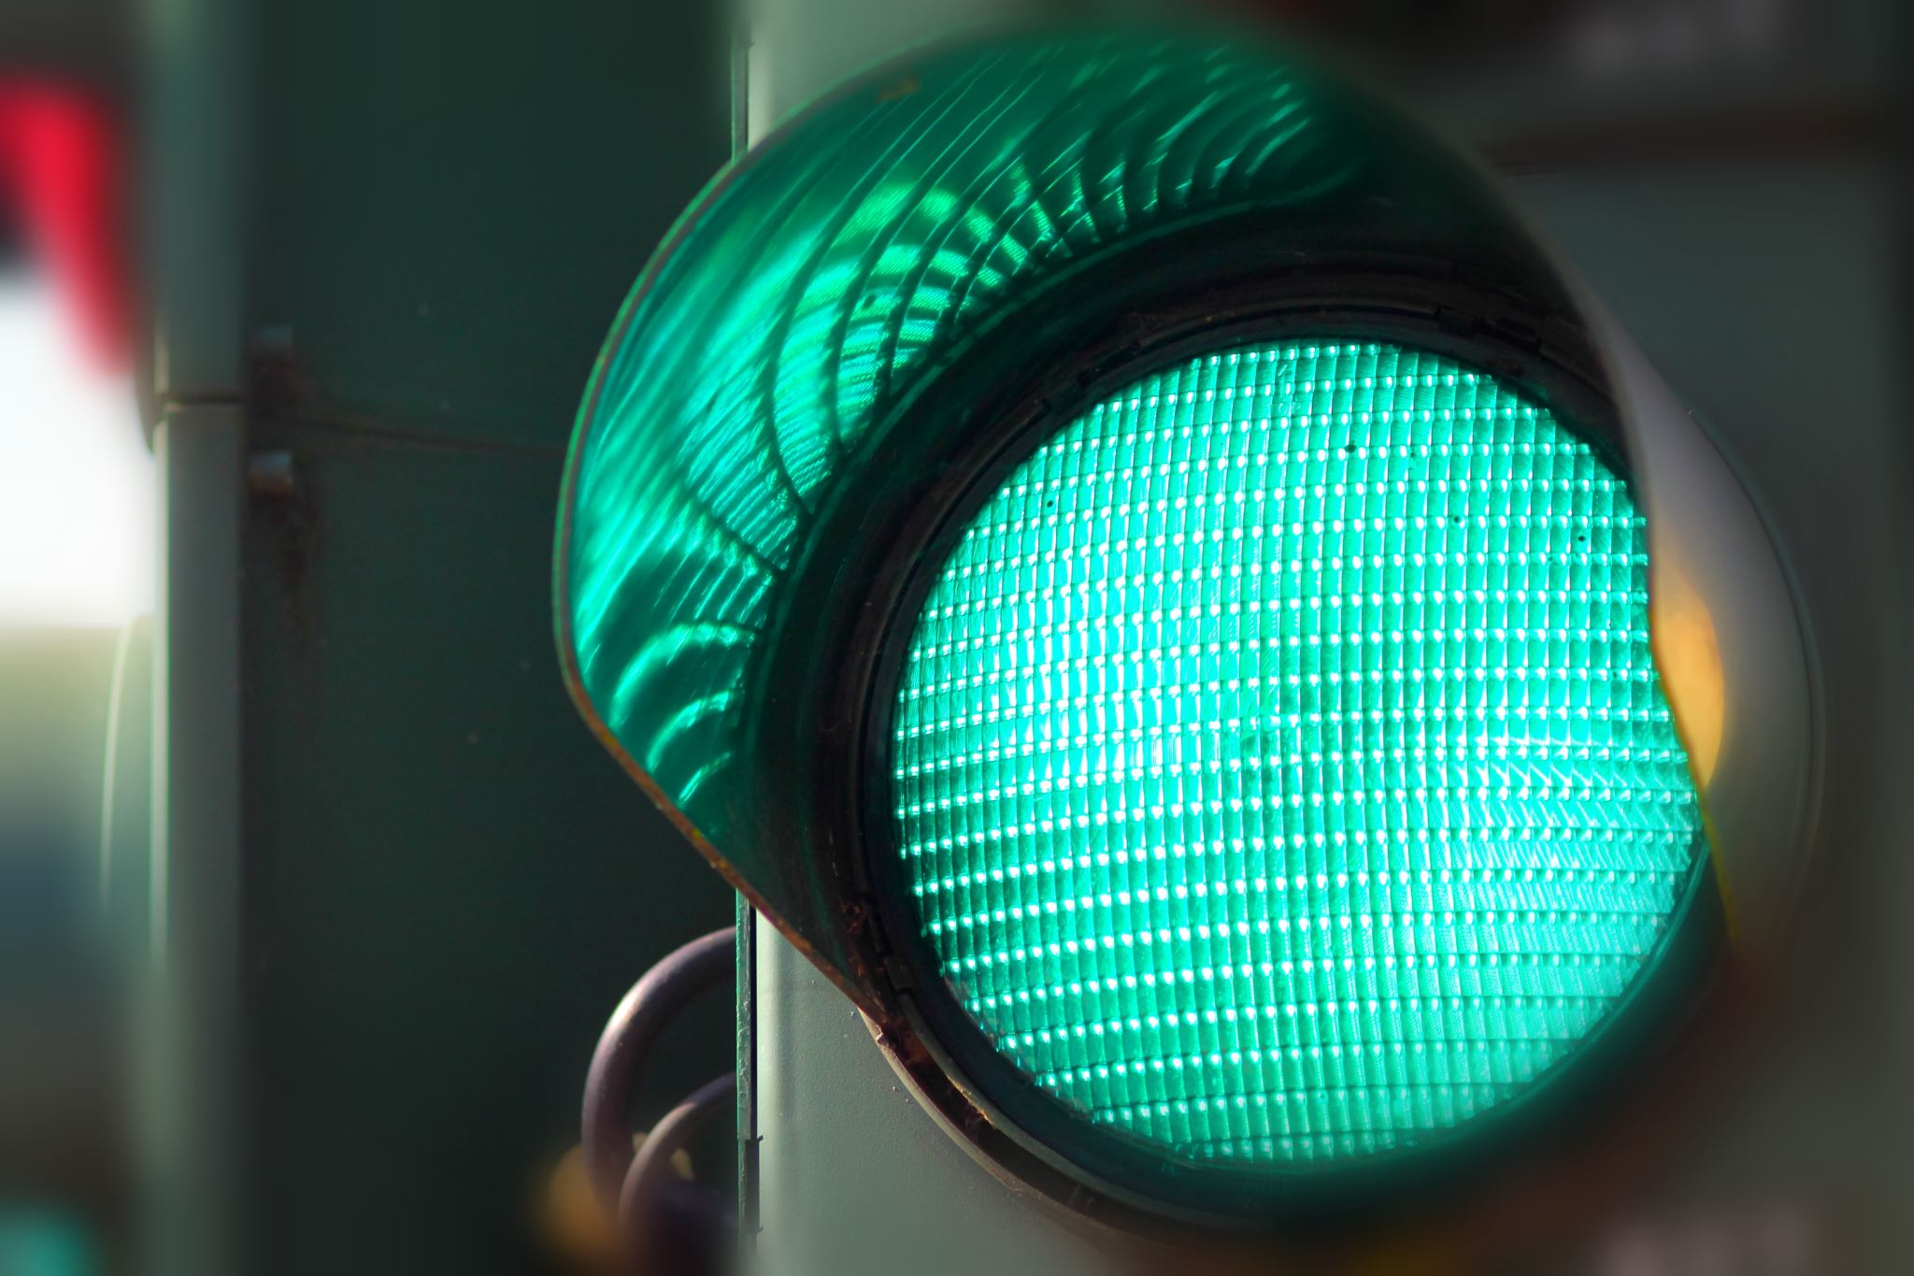
Road sign detection and recognition using deep methods
A presentation by:
Bozzitelli Andrea
Cavasinni di Benedetto Pia
Taranciuc Gabriel Radu

Slide 2
Why detect and recognize road signs?
And how computer vision and deep convolutional networks can help us achieve what we want

Slide 3
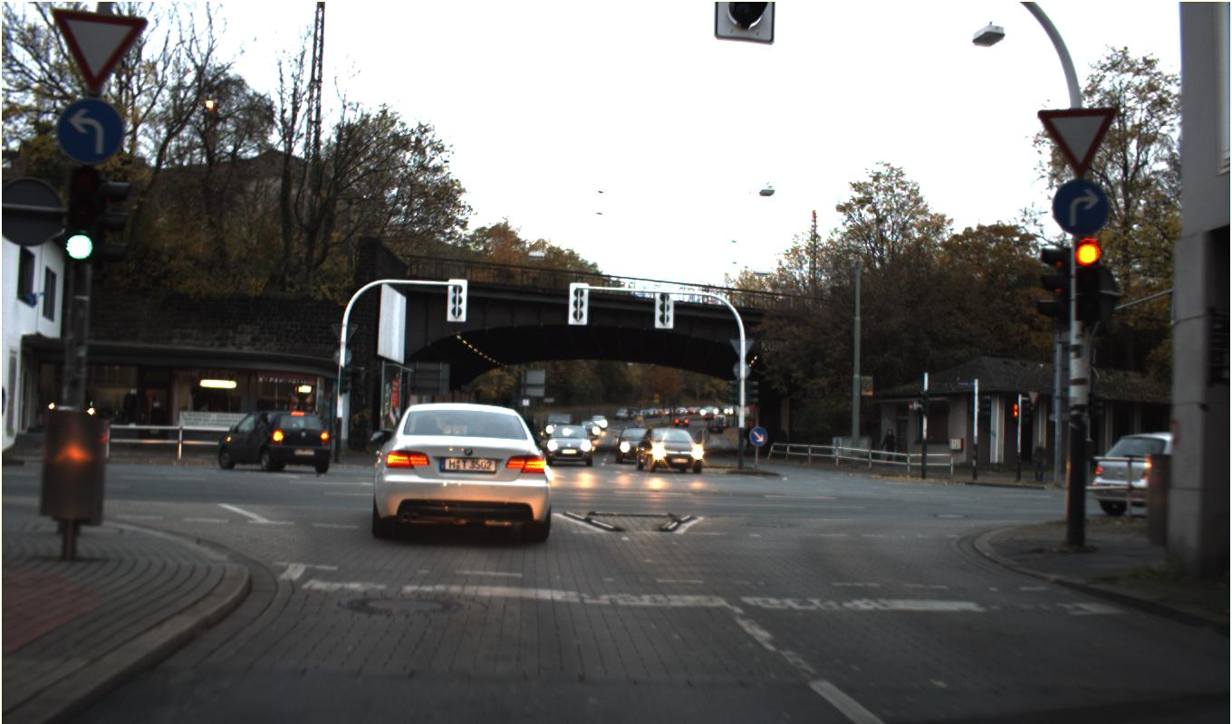
Road signs are everywhere!
While pedestrians can take their time looking for signals, this does not always hold true while driving, and missing some can happen Can you spot all the signs in the picture?
Hint: there are 5 of them

Slide 4
The German Traffic Sign Datasets
And the tools of our trade: Python and Google Colab

Slide 5
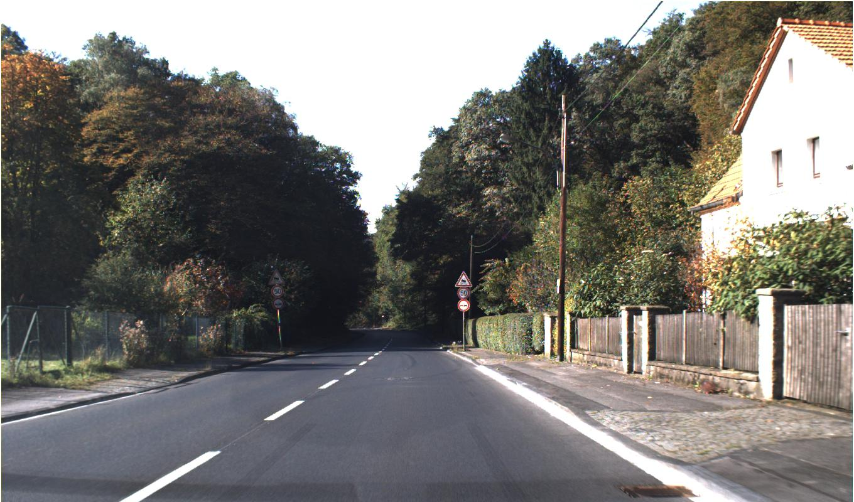
























































































































2 datasets: detection and recognition
Dashcam screenshots and similar photos
Cropped traffic signs taken from the detection dataset

Slide 6
2 Datasets: what do we have here?
Detection
Recognition
900 images
600 training samples
300 testing samples
A wide range of lighting conditions
Occluded, blurry, unfocused, far and close signs
43 represented classes (not evenly distributed)
Over 50000 samples available after data augmentation
Signs are occluded, blurry, low quality, both dark and bright and not always well cropped

Slide 7
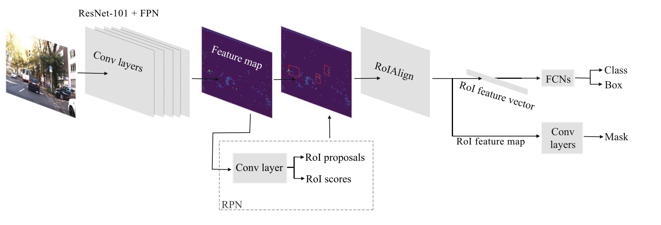
What did the best do?
Detection was carried out through the convolutional network you see below, that uses ResNet-101 and Feature Pyramids, and the results were impressive, averaging above 97% precision!

Slide 8
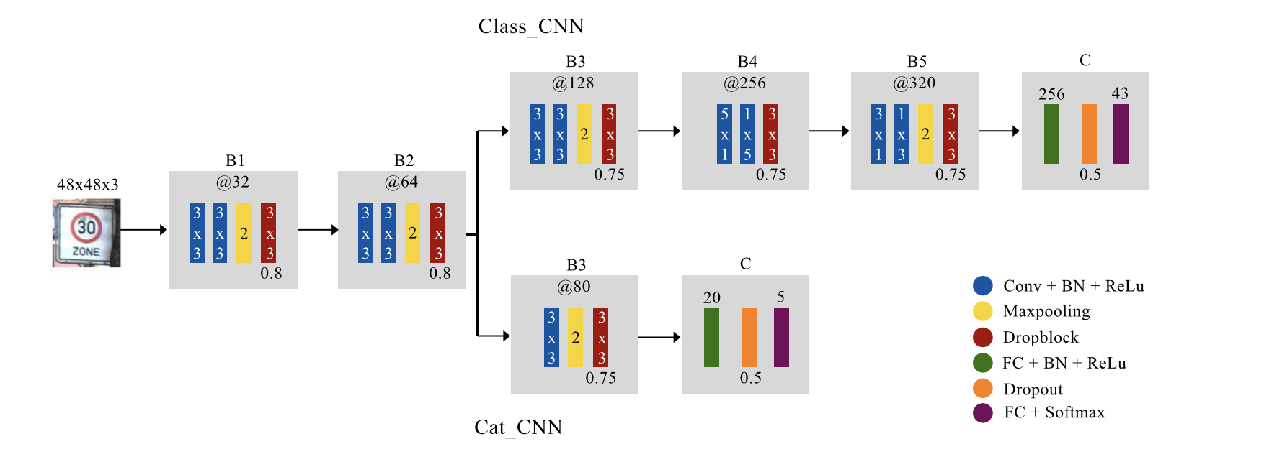
What did the best do?
Recognition on the other hand was carried out through a personalized convolutional network that does both categorization and classification for the giving signs (see below). And the results were even more impressive, averaging 99.61% precision!

Slide 9
How did we do: Detection?
Seeing the overwhelmingly good results obtained, we first gave a shot at recreating the same exact networks, training them, and giving it our shot! Pre-trained weights have not been provided by the paper publishers, so we had to re-train everything from scratch.
We recreated the entire network using Python, and, since our machines weren’t up for the job, we used Google Colab as a resource to train our networks in a timely manner.
Our first results weren’t as great as we thought, and we tried training with a very wide range of hyperparameters:
Plot twist: nothing worked even remotely well!
What are we going to do now?

Slide 10
How did we do: detection?
We figured our main problem was one we couldn’t easily solve: availability of data
Given the situation, we decided at this point it was best we tried a different method of detection altogether:
YOLO Darknet
Just as before, we still got a lot of help by using Google Colab to train on our data
And this time we got a lot better results! Our network was detecting background and signs reliably, and we did not miss the segmentation Mask_RCNN provided
This meant we could move on to…

Slide 11
How did we do: Recognition?
And for this one, as before, we first tried our chances by first recreating the same network the publishers did and, after some heavy data augmentation, train it
And this time we got lucky: we trained two different networks:
A carbon copy of the network used in the paper
Another with variations in the size of the feature vectors
Since both performed extremely well on the validation data, we picked the better performing one to do our testing.
Safe to say, it performed just as well as expected, very confidently recognizing sign classes that even presented severe occlusions and blurriness
In all fairness, it correctly identified some not even we could tell what they were

Slide 12
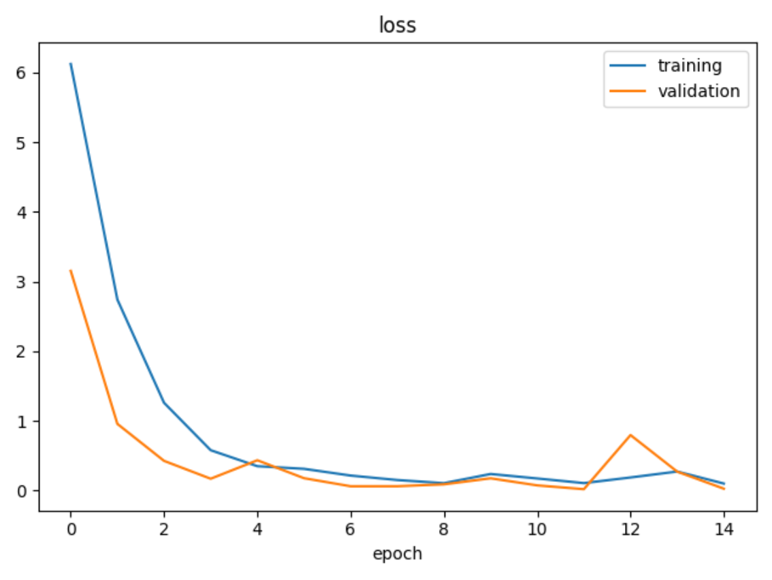
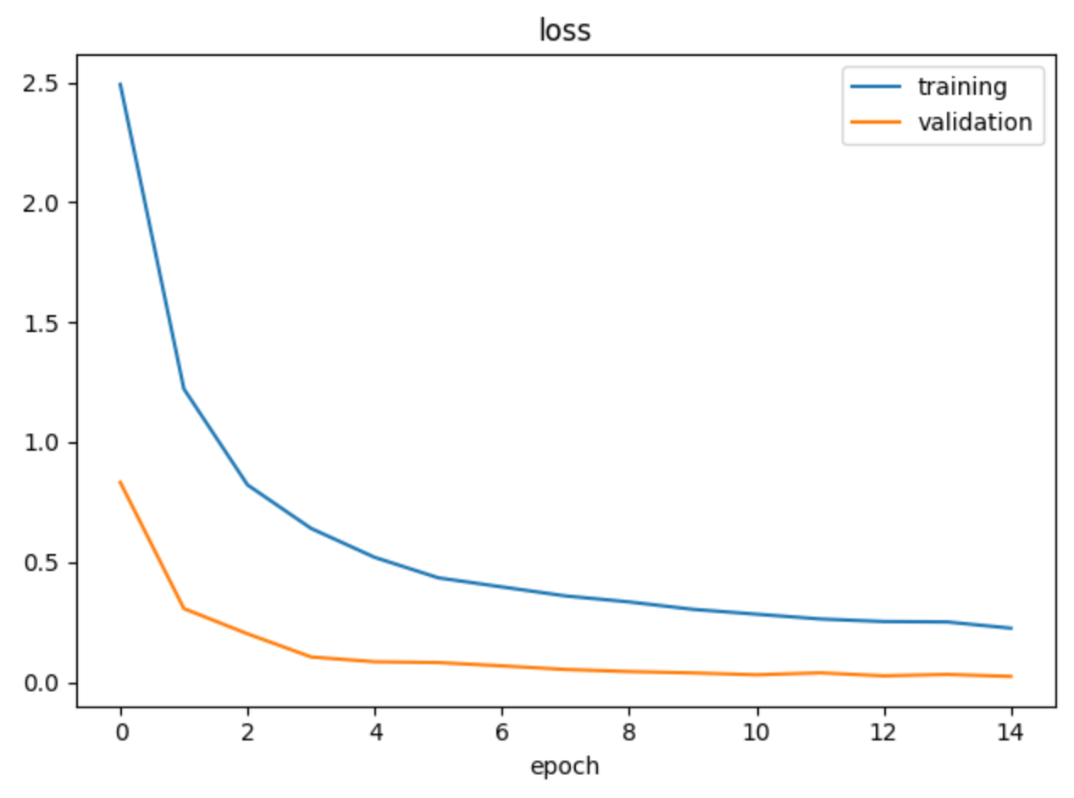
Recognition: some training data
Their unaltered network
Our slight alteration

Slide 13
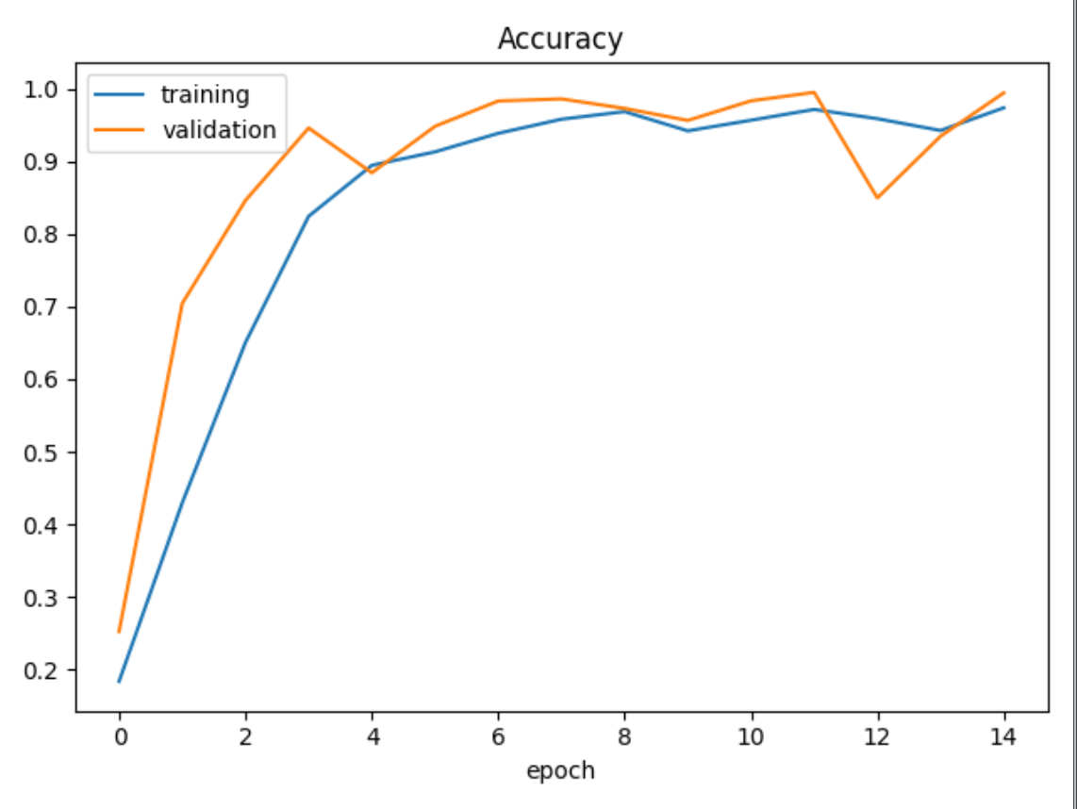
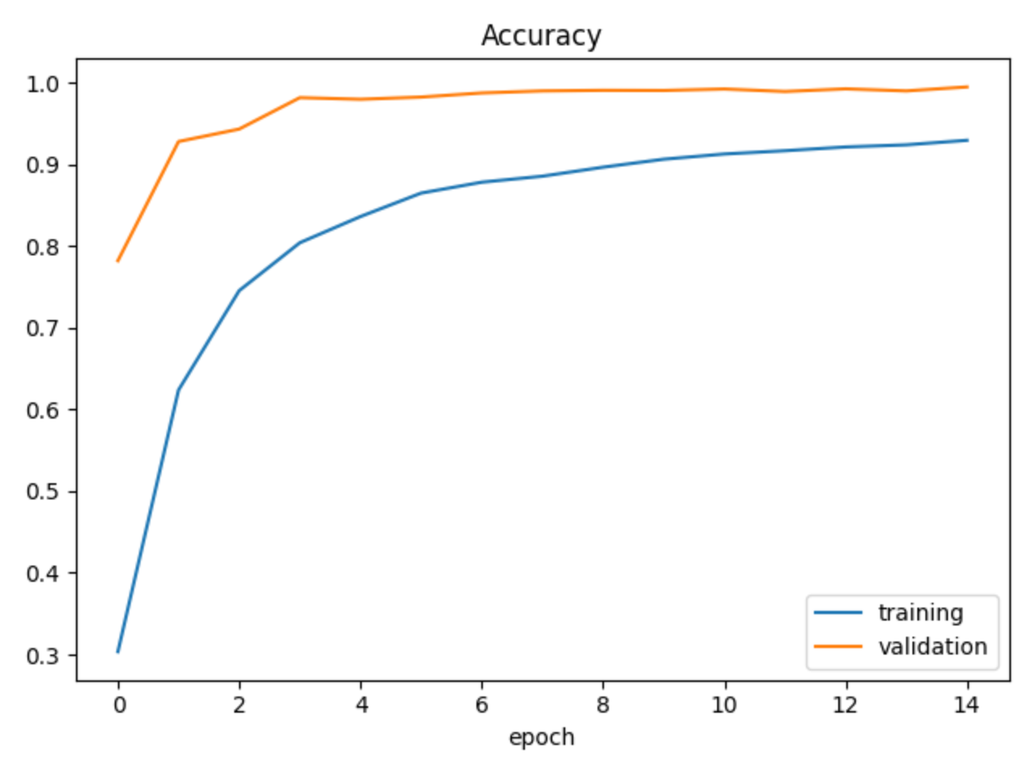
Recognition: some training data
Their unaltered network
Our slight alteration

Slide 14
Recognition: some training data
After 15 epochs of training our variation of the network, consisting of 445 steps each:
The final total loss was 0.2179
Accuracy reached a value of 0.9529
And then the validation set decided to surprise us:
The loss on the validation set went as low as 0.0535
Accuracy on the validation set was 0.9855

Slide 15
How did we do: something extra?
To top it all off, we made to GUIs for ease of use, real time testing and demonstrations:
One for detecting signals on an image, which works real time given anything…
A detection + recognition one which could be improved, but works perfectly… as long as it’s German
We also tried seeing if our detector and recognizer could work on just dash-cam video samples:
AND IT DID! While not entirely real time, it will confidently handle signals on video and track them better than many detectors, while also recognizing what it has found!

